Slide 1
Java Lambda
Functional Programming

Slide 2
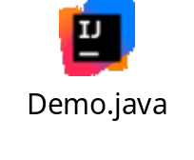
Swap two Numbers
Write 3 swap methods. swap1, swap2 and swap3.
Use Temporary variable to swap 2 numbers in swap1 method.
Use Addition and Subtraction without temporary variable to swap 2 numbers in swap2 method.
Use Multiplication and Division without temporary variable to swap 2 numbers in swap3 method.
Call three swap methods in main method.

Slide 3
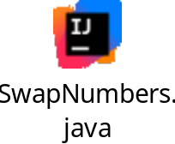
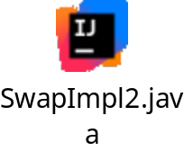
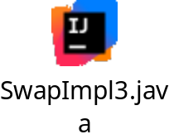
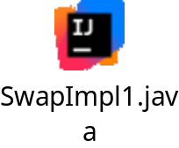
Interface and Implementation Classes
Create package utils.
Write Interface SwapNumbers with single Abstract Method swap.
Write Class SwapImpl1 by implementing Interface SwapNumbers and implement swap method with temporary variable.
Write Class SwapImpl2 by implementing Interface SwapNumbers and implement swap method with addition and subtraction.
Write Class SwapImpl3 by implementing Interface SwapNumbers and implement swap method with multiplication and division.
Test 3 swap implementations in main method.

Slide 4
Anonymous Classes
Write 3 anonymous classes to implement 3 swapping techniques.
Create interface object by implementing anonymous class and call swap method.

Slide 5
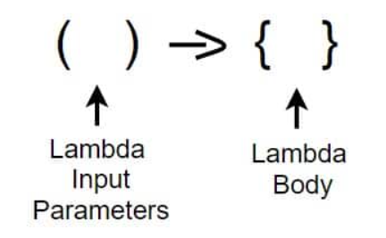
Lambda Expressions
Convert Anonymous classes into Lambda Expressions.
Run the program.

